Slide 1

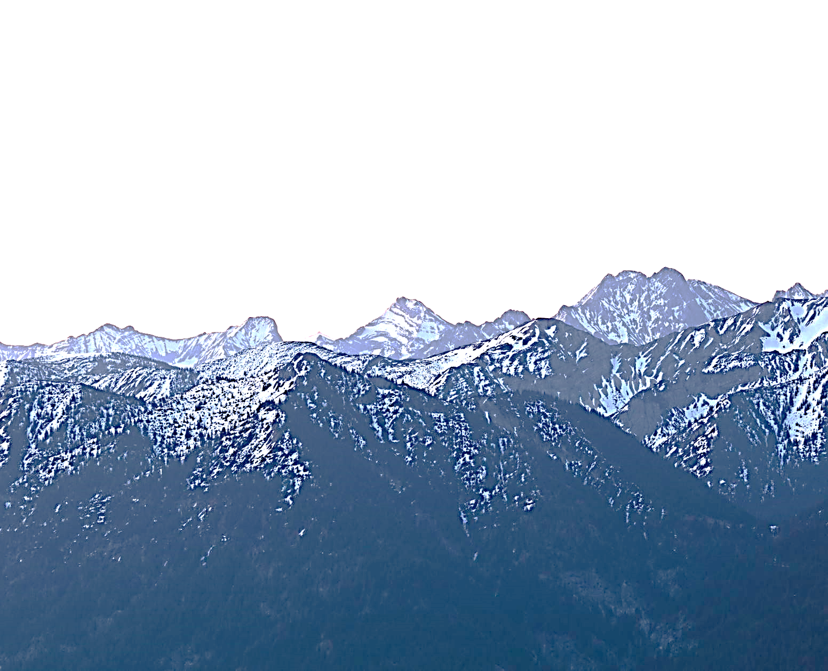
Predicting Hike Times

Slide 2
o A minimum of 5 variables in your dataset used during your analysis (for help with selecting, the author made his selection on page 6 of your book). Consider what you think could have an impact on your question – remember this is never perfect, so don’t be worried if you miss one
(Chapter 1).
moving_time_hours
length_miles
max_elevation_feet
uphill
max_speed_mph
difficulty_num

Slide 3
o Describe what the 5 variables mean in the dataset (Chapter 1).
moving_time_hours - total time spent hiking in hours
length_miles - total length of hike in
miles max_elevation_feet - highest elevation of hike in feet
uphill - elevation gain (in feet)
maximum_speed_mph - fastert hiking speed in miles per hour
difficulty_num - difficulty of hike on a scale of 1-5 (5 being the hardest) as determined by hiker

Slide 4
o Include a histogram of each of the 5 variables – in your summary and analysis, identify any outliers and explain the reasoning for them being outliers and how you believe they should be handled (Chapter 2).

Slide 5
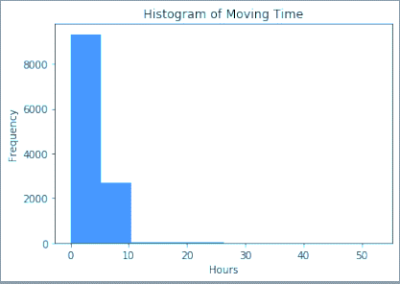
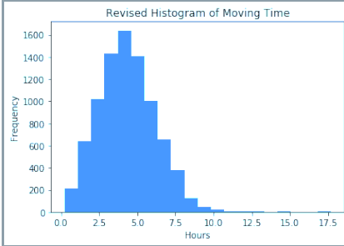
Outliers are significantly impacting the histograms. Will remove zero and nan values and make some assumptions regarding maximum values and then rerun the histograms. For this analysis, I am assuming these are day hikes as opposed to overnight backpacking trips and making the following maximum assumptions about the variables to eliminate likely outliers:
Histogram of Hiking Time with Outliers
Histogram of Hiking Time with Outliers removed - The time spent hiking is highly unlikely to exceed 20 hours in one day

Slide 6
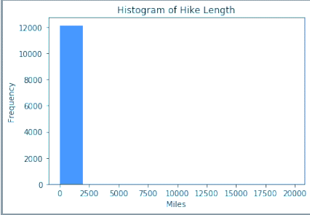
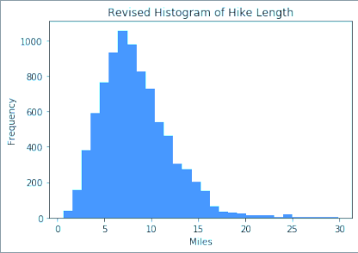
Histogram of Hike Length with Outliers
Histogram of Hike Length with Outliers removed – length of the hike in miles is highly unlikely to exceed 30 miles in one day.

Slide 7
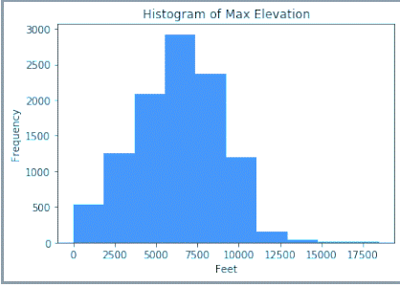
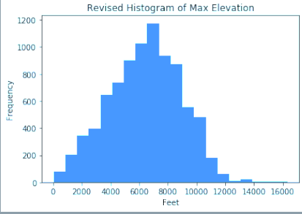
Histogram of Max Elevation with Outliers
Histogram of Max Elevation with Outliers removed – The maximum elevation is highly unlikely to exceed 20,000 feet

Slide 8
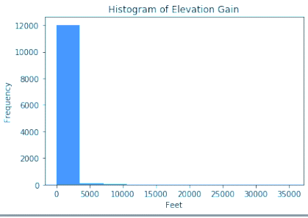
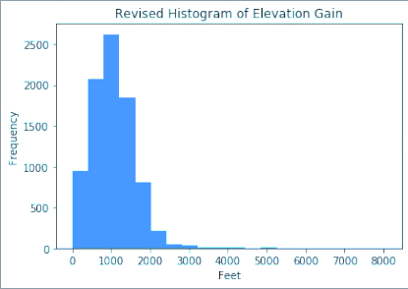
Histogram of Elevation Gain with Outliers
Histogram of Elevation Gain with Outliers removed – Elevation gain is unlikely to exceed 10,000 feet

Slide 9
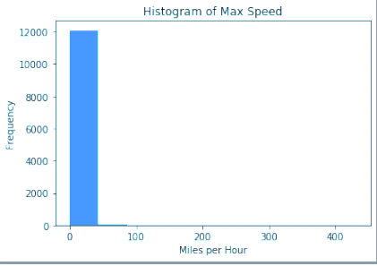
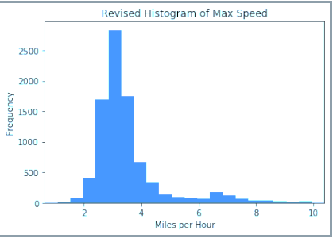
Histogram of Maximum Speed with Outliers
Histogram of Maximum Speed with Outliers removed – Hiking speed unlikely to exceed 10 mph.

Slide 10
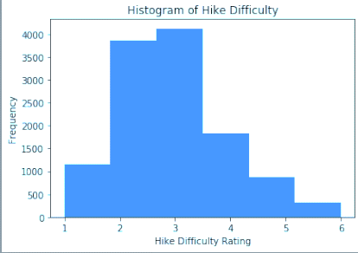
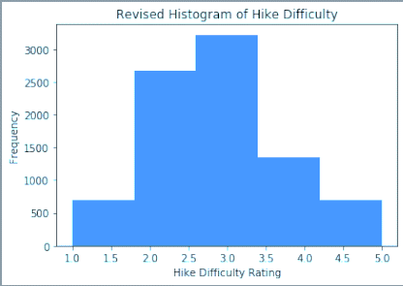
Histogram of Hike Difficulty with Outliers
Histogram of Hiking Difficulty with Outliers removed – Hike Rating should be from 1 (least difficult) to 5 (most difficult)

Slide 11
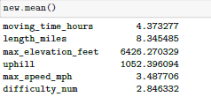
o Include the other descriptive characteristics about the variables: Mean, Mode, Spread, and Tails (Chapter 2). Mean:

Slide 12

Mode:

Slide 13
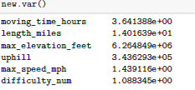
Spread - Variance:

Slide 14
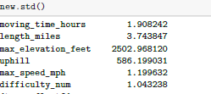
Spread - Standard Deviation:

Slide 15
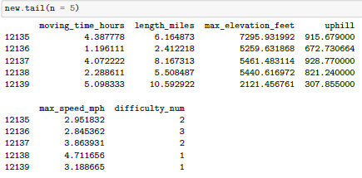
Tails:

Slide 16
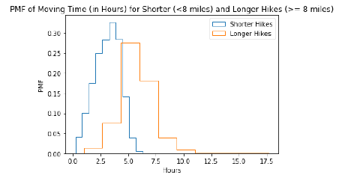
o Using pg. 29 of your text as an example, compare two scenarios in your data using a PMF. Reminder, this isn’t comparing two variables against each other – it is the same variable, but a different scenario. Almost like a filter. The example in the book is first babies compared to all other babies, it is still the same variable, but breaking the data out based on criteria we are exploring (Chapter 3).

Slide 17
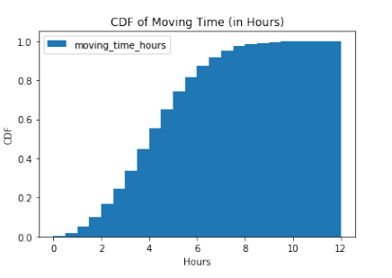
o Create 1 CDF with one of your variables.
Using page 41-44 as your guide, what does this tell you about your variable and how does it address the question you are trying to answer (Chapter 4).
The CDF tells me that there are only a small number of hikes less than 1 hour in length. The CDF tends to increase at a greater rate after 2 hours and then maintains that rate until about 6 hours. The rate of increase then slows between about 6-8 hours and tends to level off between 8-10 hours. Also, since the distribution of moving time in my dataset resembles a normal distribution, I should have more tests available to answer my questions and prove my hypothesis.

Slide 18

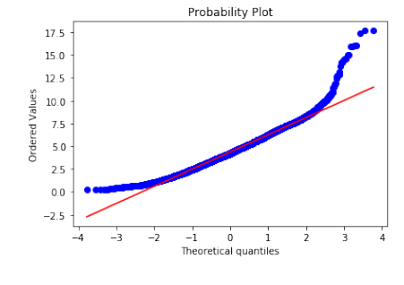



o Plot 1 analytical distribution and provide your analysis on how it applies to the dataset you have chosen (Chapter 5).
The probability plot for the moving time in hours indicates a mostly normal distribution, except in the tails. Having a normal distributuion is an assumption for most test statistics so important for proving my hypothesis.

Slide 19
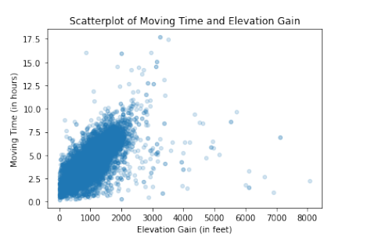
o Create two scatter plots comparing two variables.

Slide 20
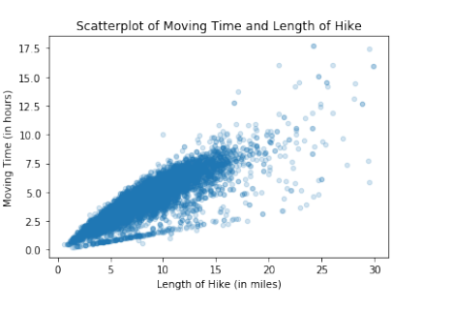

Slide 21
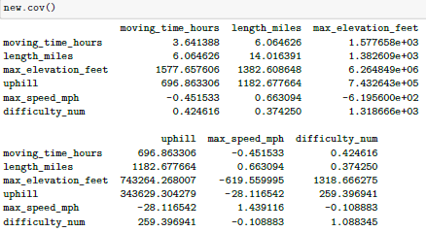
Provide your analysis on correlation and causation. Remember, covariance, Pearson’s correlation, and Non-Linear Relationships should also be considered during your analysis (Chapter 7). Co-Variance

Slide 22

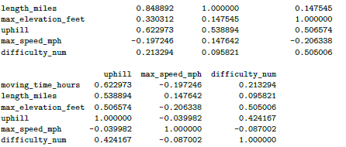
Correlation: The strongest correlations with moving time are the length of the hike (.85), elevation gain (uphill = .62), the max elevation (.33), and the hike difficulty (.21). These correlations seem reasonable. There appears to be a negative correlation between maximum speed and the time spent hiking. However, it does appear plausible that the maximum speed could have no impact on the time spent hiking, as one could potentially run for a few seconds to increase the maximum speed and then spend the rest of the hike hiking at a slower pace. The relationships between variables seem to be approximately linear.

Slide 23

o Conduct a test on your hypothesis using one of the methods covered in Chapter 9. Under classical hypothesis testing, the steps are as follows: 1) Quantify the size of the effect by choosing a test statistic The test statistic I chose is testing a correlation (see below). Since we have a roughly normal use Pearson's correlation. 2) Define the null hypothesis The null hypothesis is that the length of the hike has no impact on the time spent hiking. 3) Compute p-value The p-value is less than .01 so statistically significant. We can reject the null hypothesis, 4) Interpret the result There is a positive correlation of approximately 0.85 between the hiking time and the length of the hike.

Slide 24
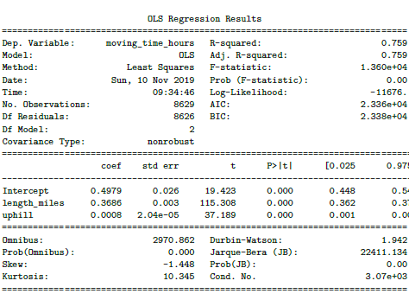
o For this project, conduct a regression analysis on either one dependent and one explanatory variable, or multiple explanatory variables (Chapter 10 & 11).
I ran various combinations of regression models using length_miles, uphill (elevation gain), max_elevation_feet, and difficulty_num (max_speed_mph has a negative correlation) as predictor variables. The highest r-squared value of .780 was a combination of length_miles, uphill, and max_elevation_feet. However, the p-value for the y-intercept was less than .05, so not significantly significant. I then tried a combination of only length_miles and uphill as predictor variables, resulting in an r-squared of .759 and all p-values less than .01. The elevation gain (uphill) doesn’t contribute much to the regression model but does provide a higher p-value than with the length of the hike as the only predictor variable. Thus, it appears that the length of the hike and elevation gain are the best predictors of the time spent hiking.

